Slide 1
12.08 Create your own challenge exam. Recursive Methods
By: Jody Rutter
Date: 7/30/2015

Slide 2
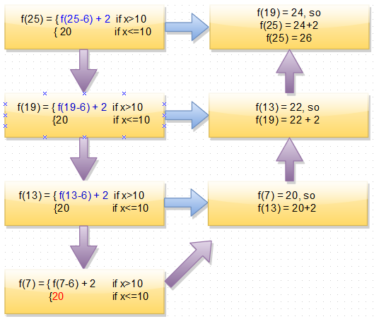
Divide and conquer
It’s like these piecewise functions.
In a recursive method, a recursive loop breaks a problem into smaller and smaller pieces, until the recursive loop reaches the base case. After the loop reaches the base case, the recursive loop works back through the problem, substituting the result of the following piece.
⬅The diagram to the left illustrates the process.
Base case: Simplest part of a recursive method that has a non-recursive value.
The base case in this diagram is colored red.
The purple arrows show the flow of control.

Slide 3
What does it mean to divide and conquer?
To divide and conquer is to break into smaller pieces and solve.
As “divide and conquer” entails, recursive methods break a problem into smaller pieces, until the method reaches the base case, then solves the smaller pieces until the main piece is solved.
Recursive methods are like iterative loops, but are expressed differently.
A recursive method is the result of a method calling itself until a condition is met that makes it stop and re-evaluate the preceding pieces.

Slide 4
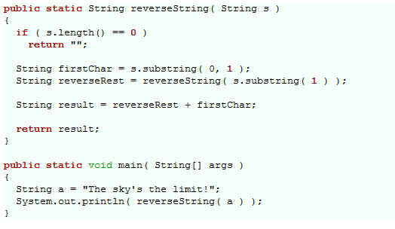
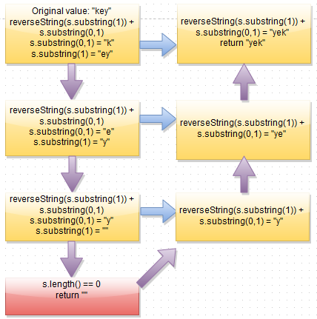
A typical recursive program
Trace through below.
The example above comes from an eIMACS program.

Slide 5
Reversestring explained
The diagram in slide 4 illustrates how to evaluate the reverseString recursive method.
When the String “key” is input in reverseString, the program calls itself and inputs the substring remaining after excluding the first letter of the string.
The program then continues this process until there are no more letters.
The program then adds the first letter of each substring up, starting with the last letter.
The program returns the value “yek”.
I have made the base case in the diagram red.
The base case in this program returns “” when the string length is 0.

Slide 6
Reversestring walkthrough
The string “key” is input in the reverseString method.
The first letter is removed, and the remainder is put through the reverse string method. The first letter is then added to the end of the result.
“ey” is put through the same process and “y” is put through reverseString.
“y” is put through the same process and “” is put through reverseString.
The base case is reached, reverseString returns the value “”.
y is added to “”, resulting in “y”.
e is added to “y”, resulting in “ye”.
k is added to “ye”, resulting in “yek”.
“yek” is returned.

